Slide 1
SECURE DATA HIDING IN IMAGE USING STEGANOGRAPHY
CAPSTONE PROJECT
Presented By:
Student Name : PETHU KANNAN G
College Name & Department : THIAGARAJAR COLLEGE OF ENGINEERING CSE

Slide 2
OUTLINE
Problem Statement
Technology used
Wow factor
End users
Result
Conclusion
Git-hub Link
Future scope

Slide 3
Problem Statement
🔹 Data security is a major concern in today's digital world.
🔹 Conventional encryption methods make data transmission obvious, attracting attackers.
🔹 Steganography provides a solution by hiding secret messages inside images.
🔹 This project implements secure data hiding in images using steganography, ensuring privacy while maintaining the integrity of the cover image.

Slide 4
Technology used
🛠 Programming Language: Python 🛠 Libraries: OpenCV (cv2) 🛠 Encryption Method: Pixel-based message embedding 🛠 Security: Password-based decryption 🛠 Operating System Compatibility: Windows/Linux

Slide 5
Wow factors
✨ Invisible Communication – Message hidden inside an image, making it unnoticeable. ✨ Dual-layer Security – Password protection ensures only authorized users can extract the hidden message. ✨ Simple Yet Effective – Lightweight and easy to implement, requiring minimal computing resources. ✨ Use of Image Pixels – Hides data without significantly altering image quality.

Slide 6
End users
👥 Cybersecurity Experts – Use for secure message transmission. 👥 Journalists & Activists – Hide sensitive information in images to avoid surveillance. 👥 Military & Intelligence Agencies – Secure covert communication. 👥 Personal Use – Users can store confidential information inside images for later retrieval.

Slide 7
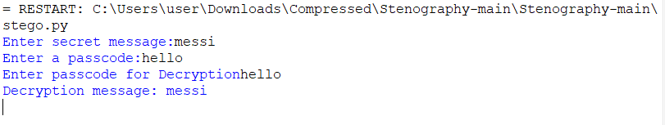
Results

Slide 8
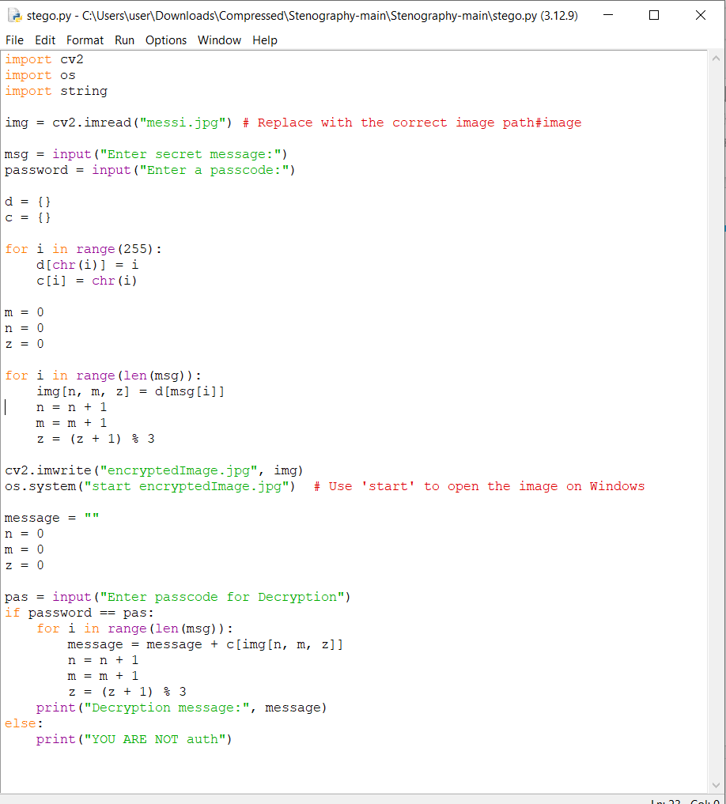

RESULTS

Slide 9
Conclusion
✅ Steganography is an effective method for hiding sensitive data in plain sight. ✅ The project demonstrates secure encoding and decoding of messages in images. ✅ Password-based authentication adds an extra layer of security. ✅ The method ensures data remains undetectable and safe from interception. ✅ Future enhancements can improve security and efficiency.

Slide 10
GitHub Link
https://github.com/PethuKannan/Securing-Data-using-Image-Steganography

Slide 11
Future scope
🚀 Advanced Encryption – Integrating AES or RSA encryption before embedding the message. 🚀 AI-Powered Steganography – Using deep learning to enhance security and make detection impossible. 🚀 Multi-layer Steganography – Hiding data within different layers of an image for extra security. 🚀 Cross-Platform Support – Developing mobile and web-based applications. 🚀 Audio & Video Steganography – Expanding the project to support hiding messages in audio and video files.

Slide 12
THANK YOU

